Slide 1
Quick Start Support
Overview of Quick Start References
What are Quick Starts?
QuickStart Concepts
Modularity
Portability
Where are they published?
Issue Resolution
How to validating bugs
How to engage the QuickStart Team/Community
How to use taskcat to aid in troubleshooting

Slide 2
Quick Start Concepts
Modularity
Portability

Slide 3
What are Quick Starts?
Quick Starts are automated reference deployments for key workloads on the AWS Cloud.
Each Quick Start launches, configures, and runs the AWS compute, network, storage, and other services required to deploy a specific workload on AWS, using AWS best practices for security and availability.
More info: https://aws.amazon.com/quickstart/faq/

Slide 4
Quick Start Concepts

Slide 5
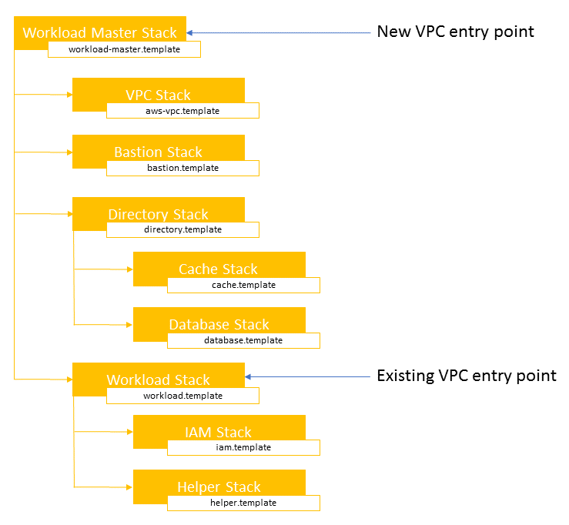
Modularity
The master template deploys one or more nested stacks, depending on the Quick Start.
One or more of those nested stacks will deploy the actual workload of the Quick Start, while the others will be referenced as submodules (inside the /submodules/quickstart-repo-name folder for each referenced Quick Start in Git at a particular commit level).
This ensures that the reference is repeatable and does not change unexpectedly.

Slide 6
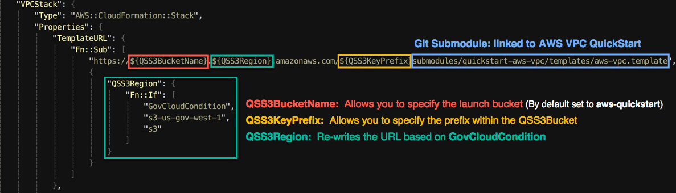
Portability

Slide 7
How are Quick Starts Maintained?

Slide 8
Maintenance Structure
All Quick Starts are opensource projects that are maintained by the Quick Start Community (AWS/Partner/End User)
Quick Start Community

Slide 9

Quick Start automated workflow
All changes to Quick Starts are validated by our CI/CD System
Stage 1
1
2
3
pull request
us-east-1
+
=
us-west-1
+
ap-northeast-1
git commit
develop
master
eu-west-2
git merge
Changes Enter the code base via the develop branch
Quick Start CI
Stage 2
4
+
/quickstart-name/assets
s3://aws-quickstart
QuickStart CI

Slide 10
Community Support

Slide 11
Support Structure
If a customer calls support and the engineer discovers/validates a bug an issue must be filed in GitHub so the community is aware that a potential bug has been discovered.
QuickStart Community
AWS User
AWS Support
Depending on the issue we may need to engage the partner/vendor to assist in the resolution.

Slide 12
Community based resolution
Benefits of engaging the “community”
Encourage the user to open the issue in GitHub (join the community)
Its possible that a community member is already working on the issue.
Its possible that the newly discovered bug sheds light on an existing issue.
Quick Start Community
Could be an upstream issue and workaround may be available.

Slide 13
Issue Resolution Steps
Validate that the issue is not a false positive or end user error.
1. Pre Stack Validation
- Validate that customer is not hitting a resource limit
- VPC/Instance type etc.
- Check for valid product licenses and or OS registration -> Direct them to the vendor as needed.
- If Marketplace AMI- make sure that subscription is active.
- Record and validate that stack inputs are valid –> use input files so that troubleshooting steps are consistent
2. Ensure that customer is not impacted by AWS Service bug/outage/degradation
Launch Stack to recreate the potential issue using customer inputs (use TaskCat to aid in troubleshooting)
If stack fails collect logs:
- cloud-init
- cfn-init
- application logs (if available)
Note: If you can’t recreate the issue it will be difficult for us to act on it

Slide 14
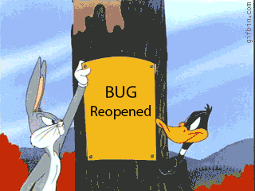
Issue Resolution Steps
Escalating to the Partner
Before escalating to the partner, Quick Start team will request the stack inputs and logs to replicate the issue.
Attach logs and json input file to the GitHub issue
(see using taskcat section for more info).

Slide 15
Bug Validation & TaskCat

Slide 16

TaskCat
What is TaskCat ?
TaskCat is a opensource tool written in Python. It is developed and maintained by the Quick Start community
TaskCat also powers the Quick Start CI System
Every change that is published to the master branch of a Quick Start runs through TaskCat
What can TaskCat do?
Stages code s3 for testing (1 or many regions)
Uses input file to pass input parameters to stack create
Uses runtime-injection to dynamically generate stack inputs
Collect logs from the cfn stack (including nested stacks)
Cleans up stacks and staging assets
Generates test reports for every requested test region
More details to come..

Slide 17
Consistency in troubleshooting
For proper discovery ensure that you are using same inputs as the customer.
Invalid user input can lead to elongated resolution time
TaskCat input files are a good way to achieve this
(allow for consistent stack creation during debugging)
Manually entering inputs into the console can lead to user induced error
X
Partner/Users that are familiar with Quick Start may have knowledge of TaskCat and have input files ready.
If they are not familiar with input files ask for a screenshot of parameters tab from CloudFormation console.

Slide 18
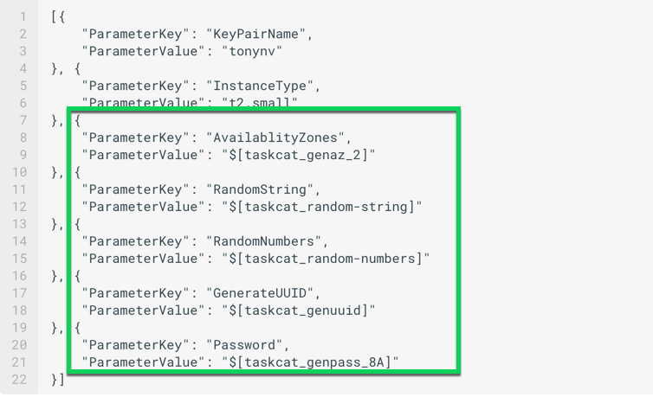
Runtime Injection
TaskCat input file and runtime-injection
Taskcat input file is a json object containing
Parameter Keys and Values
Note: you can json inputs directly with CloudFormation cli
The example here shows an input file for a stack that requires seven parameters:
KeyPair
InstanceType
AvailablityZones
RandomString
RandomNumbers
GenerateUUID
Password
The ParameterValues in green box will get evaluated by TaskCat and replaced before stack_create is called with environmentally specific (region) values

Slide 19
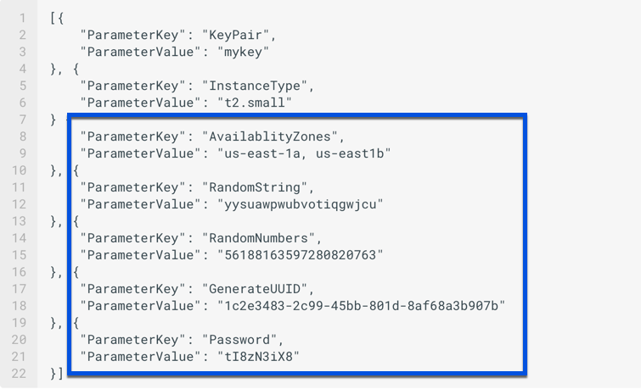
Runtime Injection
TaskCat input file and runtime-injection
Taskcat input file is a json object containing
Parameter Keys and Values
More info: https://aws-quickstart.github.io/taskcat/#more-information-on-taskcat-runtime-injection
KeyPair
InstanceType
AvailablityZones
RandomString
RandomNumbers
GenerateUUID
Password
The ParameterValues in blue box are evaluated and replaced as requested
Note: All Parameters that don’t have default values will require an entry in the input file

Slide 20
How to use TaskCat

Slide 21
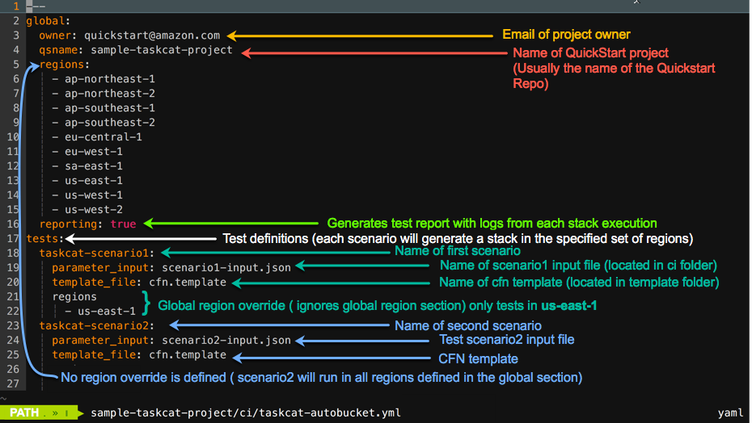
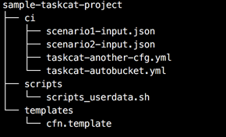
TaskCat config file
All Quick Starts have a TaskCat config file in the ci folder.
Directory structure of a simple project

Slide 22
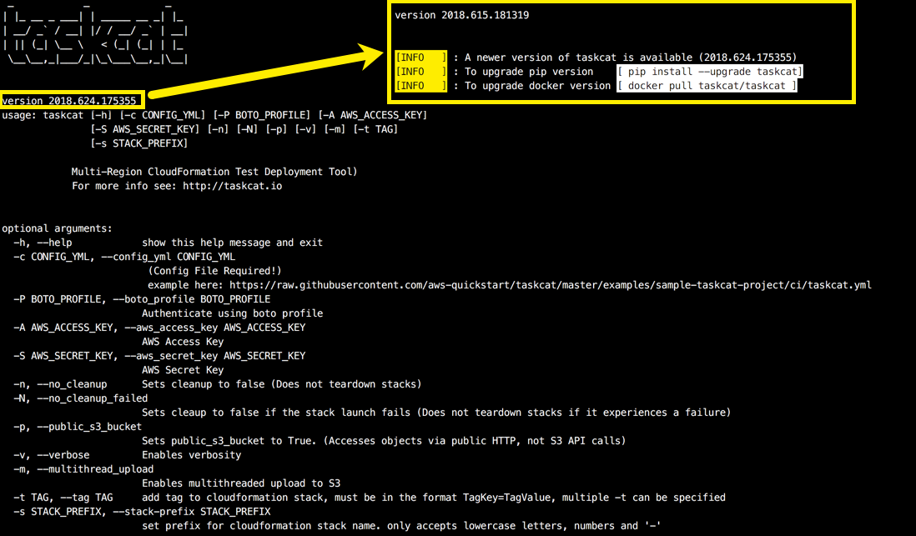
Keep Current (Screen Shots)
Running TaskCat with no argument will print the help/usage menu
# taskcat
If there is a new version of TaskCat available additional messages will be displayed informing you on how to upgrade to the latest version!

Slide 23
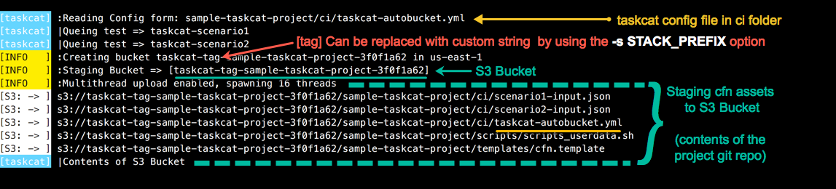
TaskCat Run (Screen Shots)
Command to start a TaskCat run:
# taskcat -c sample-taskcat-project/ci/taskcat-autobucket.yml -p -m
-p make the autogenerated bucket public
-m use multiple threads when uploading to s3

Slide 24
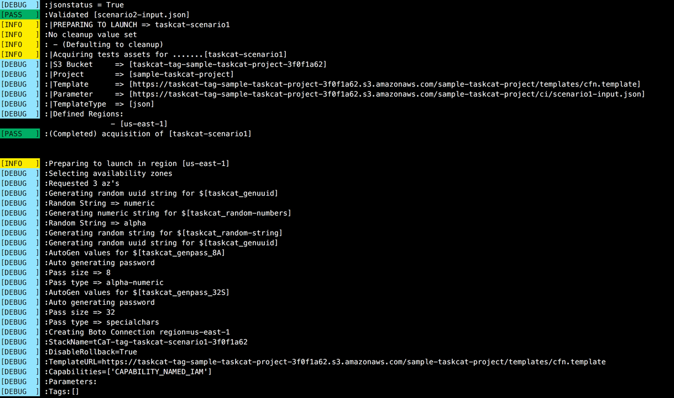
TaskCat Run (Screen Shots)
Validate template syntax using CloudFormation API and
Validates template Syntax via CFN API
Preparing launch of senario1

Slide 25
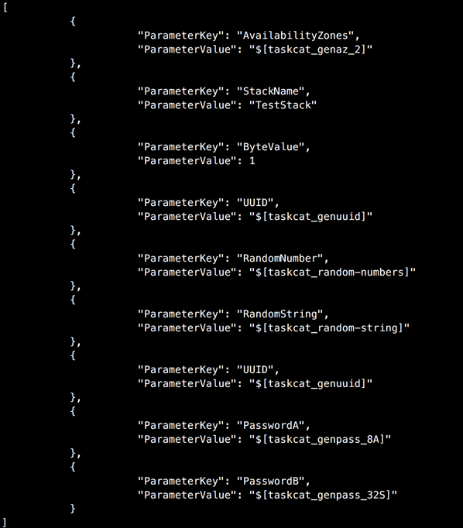
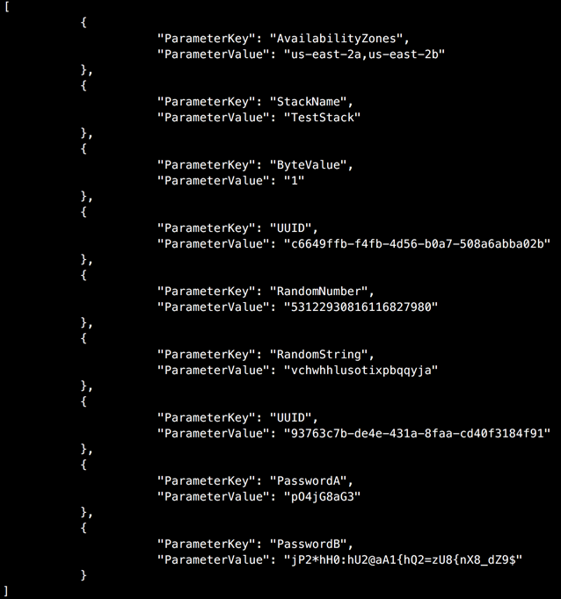
TaskCat Run (Screen Shots)
Generate inputs per scenario
Input file (left)
Evaluated values (right)

Slide 26
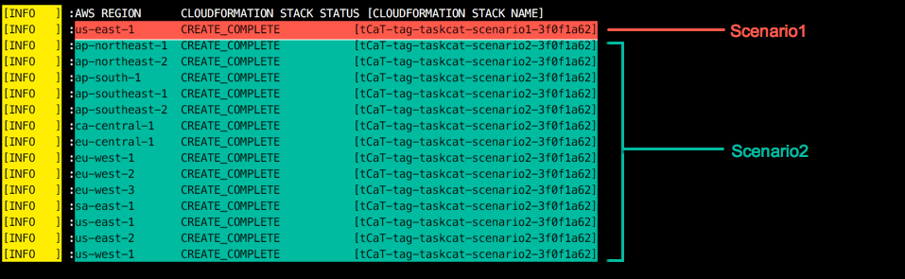
TaskCat Run (Screen Shots)
TaskCat execution

Slide 27
Installing TaskCat (Mini Lab)
Option1: pip3 install on Linux Workstation or Mac (Add python bin dir to your path)
Option2 : Install via docker
Option3 : Launch ec2 instance via CloudFormation
Option3 is recommended for users that do not have docker experience
or do not have an OSX or Linux workstation available
More info at http://taskcat.io

Slide 28
Installing taskcat
Install taskcat using pip
- Add python bin to you taskcat environment
Example MacOS = (Linux distros see here)
taskcat requires python3
Note: your python version may be python 2.7
Check your python version
– python –V
if you are using python3 the output should reflect Python 3.6.5
Install using pip3 install taskcat –user
Note: note –user will install taskcat executables in your home directory
Add Python bin to your path
export PATH=$PATH:~/Library/Python/3.6/bin

